Slide 1
Exploring Oscillon Interactions
Anamitra Paul
Advisor: Mustafa Amin
Rice University

Slide 2
Roadmap
Introduce oscillons and their physical significance
Present theoretical calculations of oscillon interaction dynamics
Compare theory to numerical simulations

Slide 3
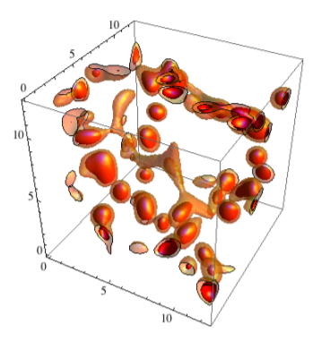
Axionic Dark Matter
Introduced to resolve the strong CP problem¹
Weak interaction strength makes them good dark matter candidates²
Described as a real-valued scalar field
(Amin et al., 2011)
¹ Peccei and Quinn (1977)
² Dine & Fischler (1983)

Slide 4
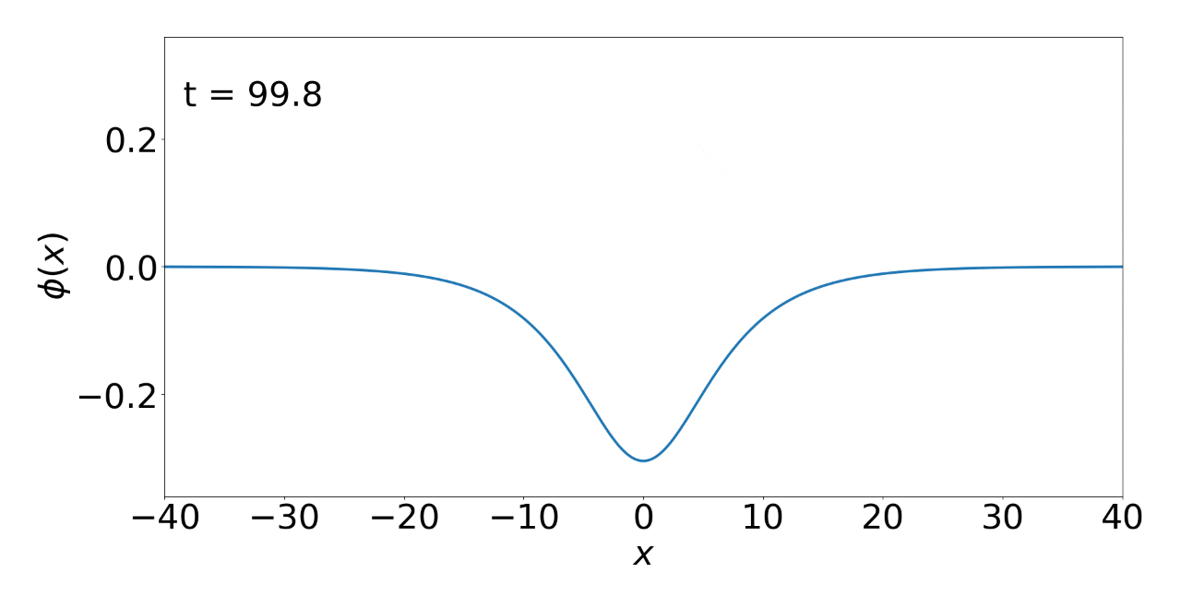
Oscillons
Long-lived, spatially localized, oscillatory field excitations³ ⁴
Provide insight into structure formation of axionic dark matter
Oscillon interactions produce gravitational waves and electromagnetic radiation⁵
³ Gleiser (1993)
⁴ Zhang et al. (2020)
⁵ Amin & Mou (2020)

Slide 5
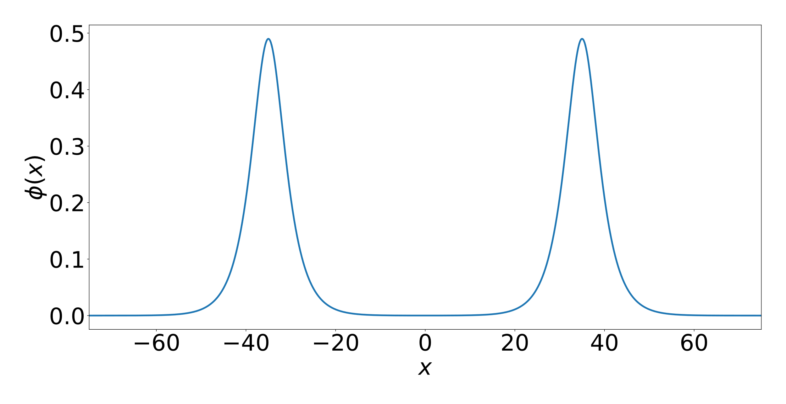
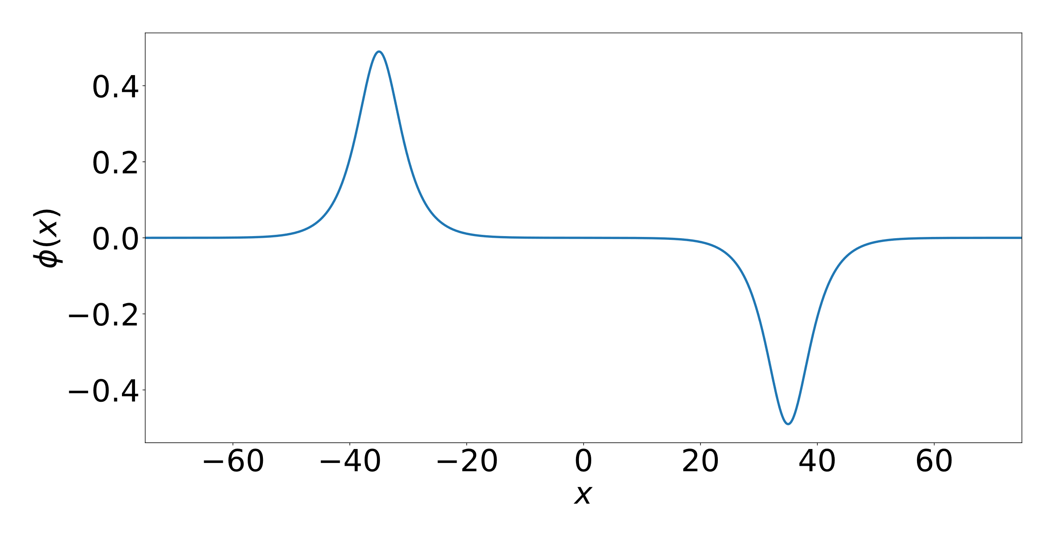
How do Oscillons Interact?
Oscillons may attract or repel each other
Quantify the “force” between two oscillons in 1+1 D spacetime (1 spatial dimension plus time)
We will ignore gravity (for simplicity)

Slide 6
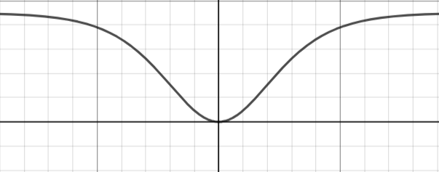
Equation of Motion in 1+1 D Spacetime

Slide 7
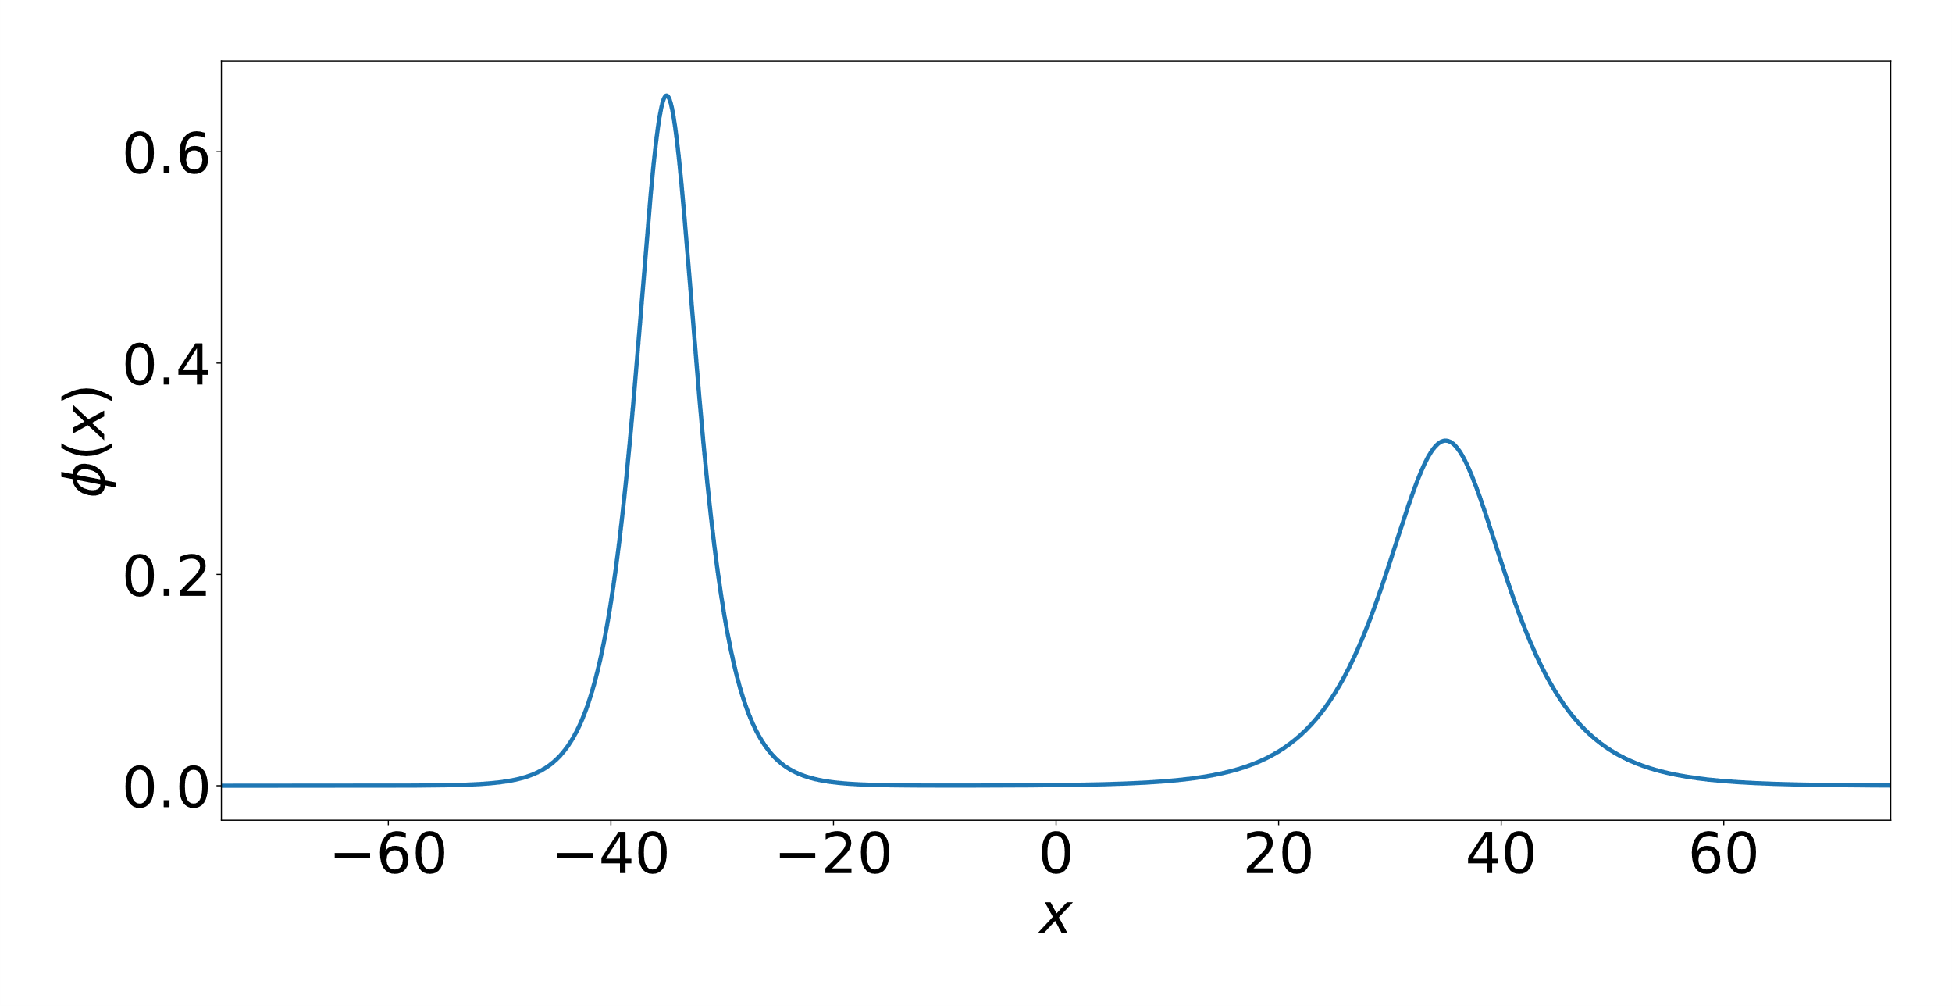
Approximate Superposition Solution
Approximate sum solution at $t=0$ with $θ=0$

Slide 8
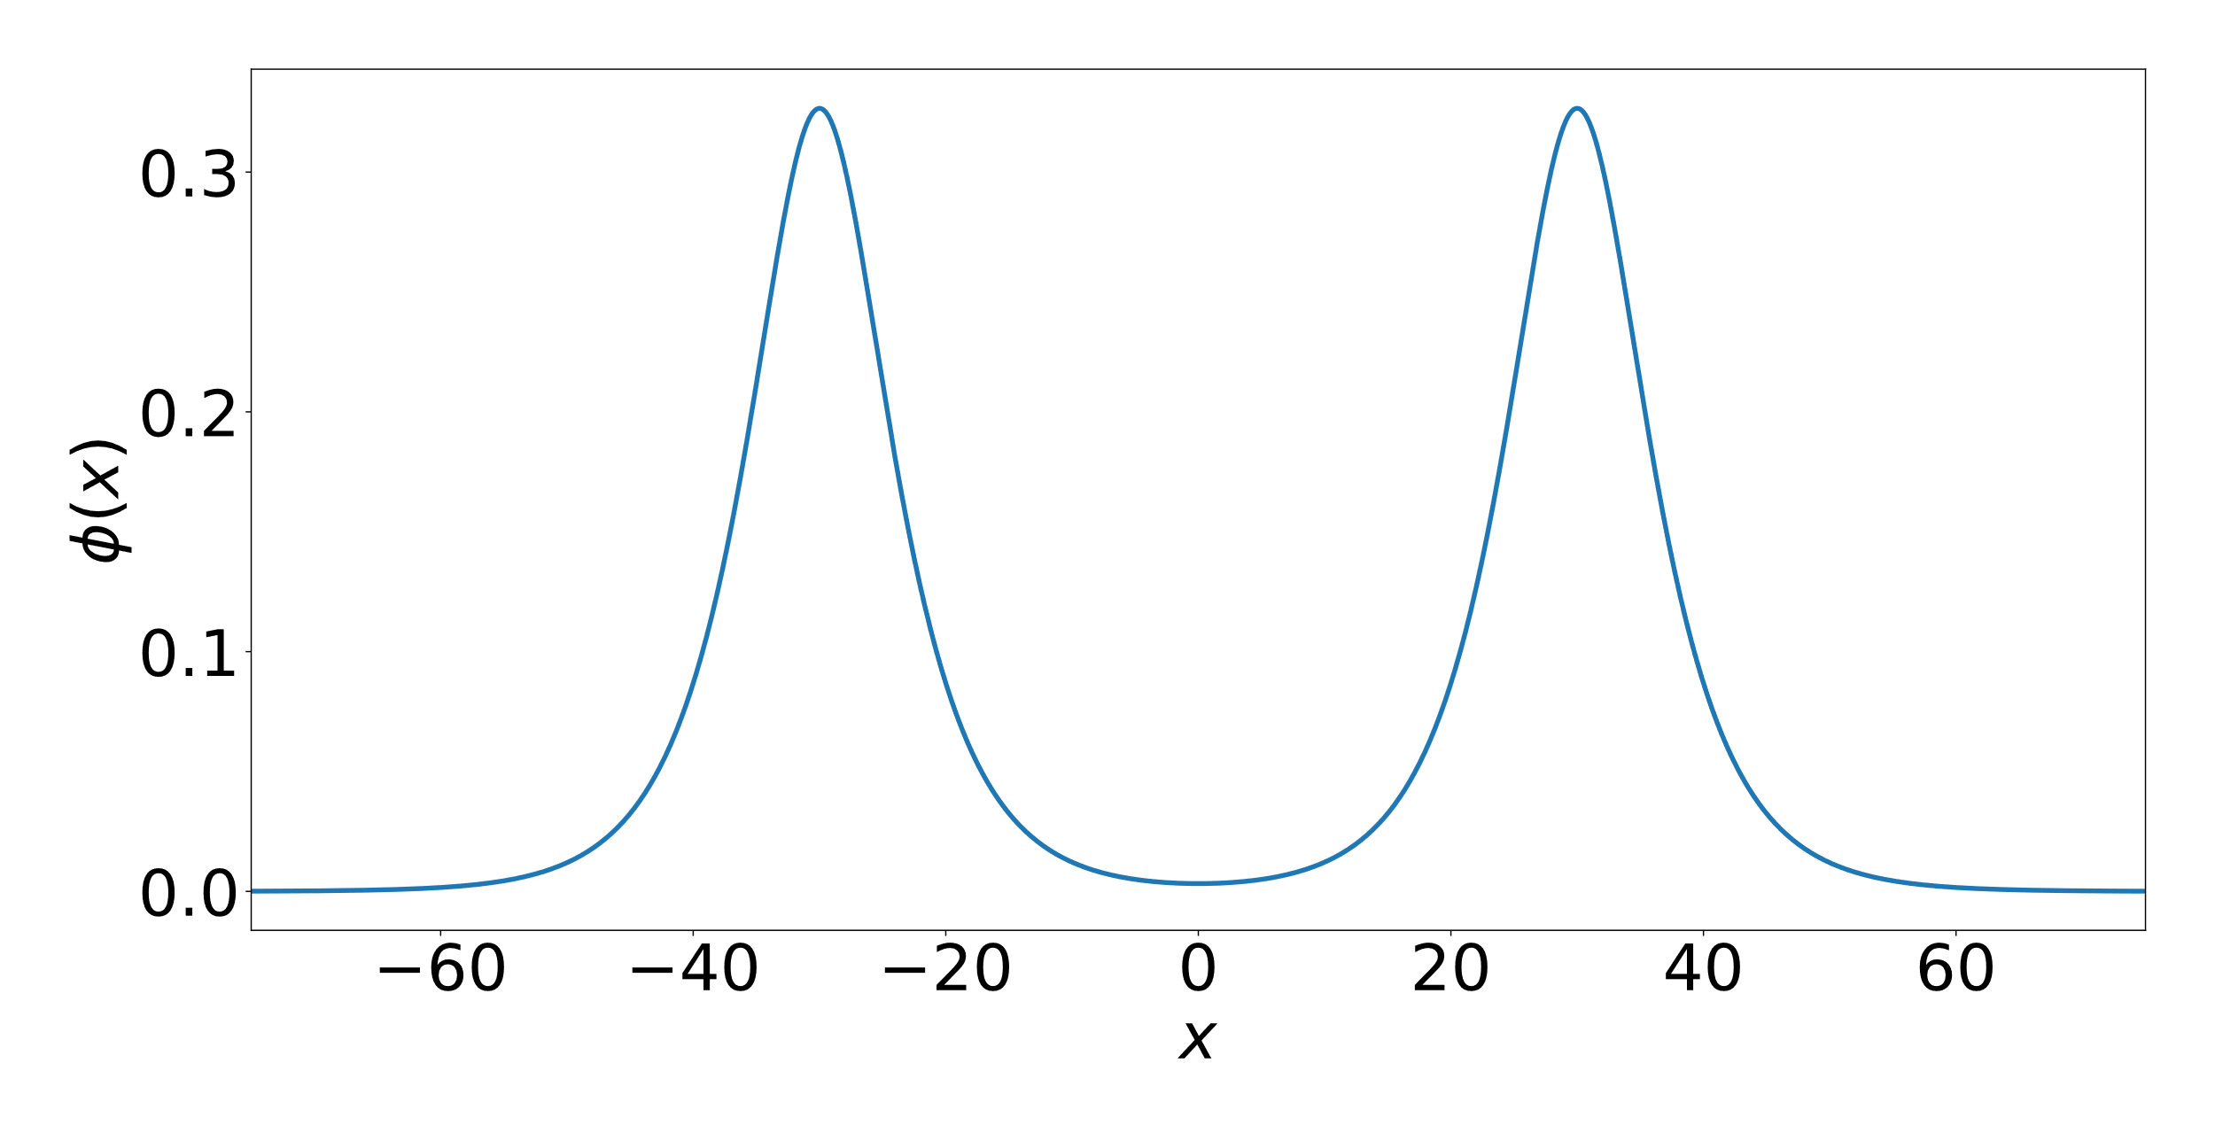
Force between Oscillons

Slide 9
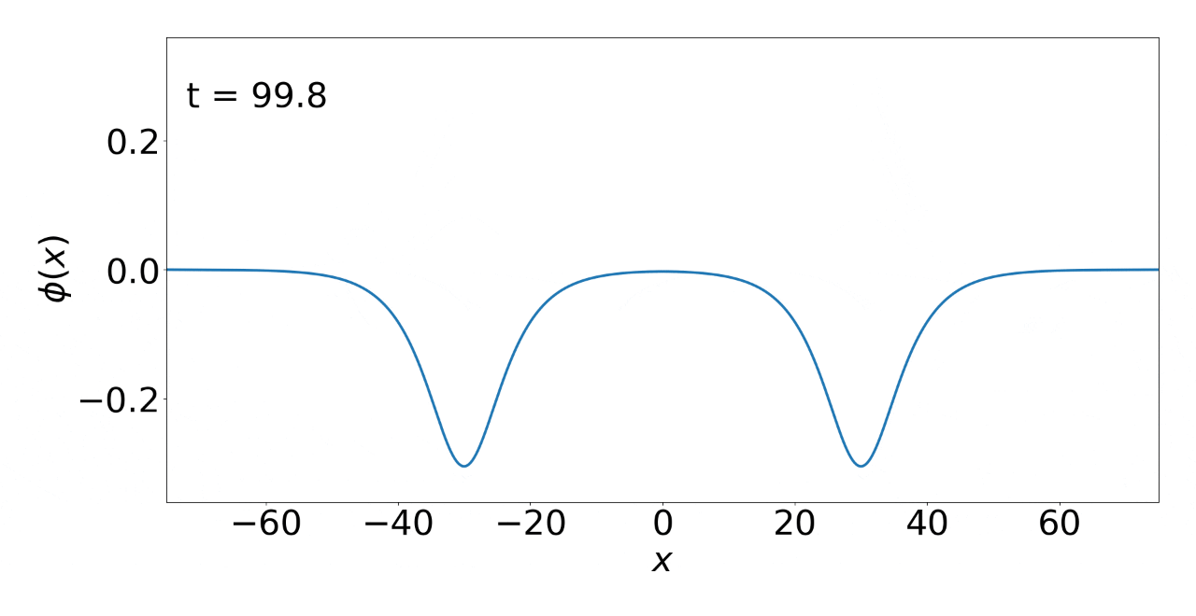
Equal Amplitude Oscillons

Slide 10
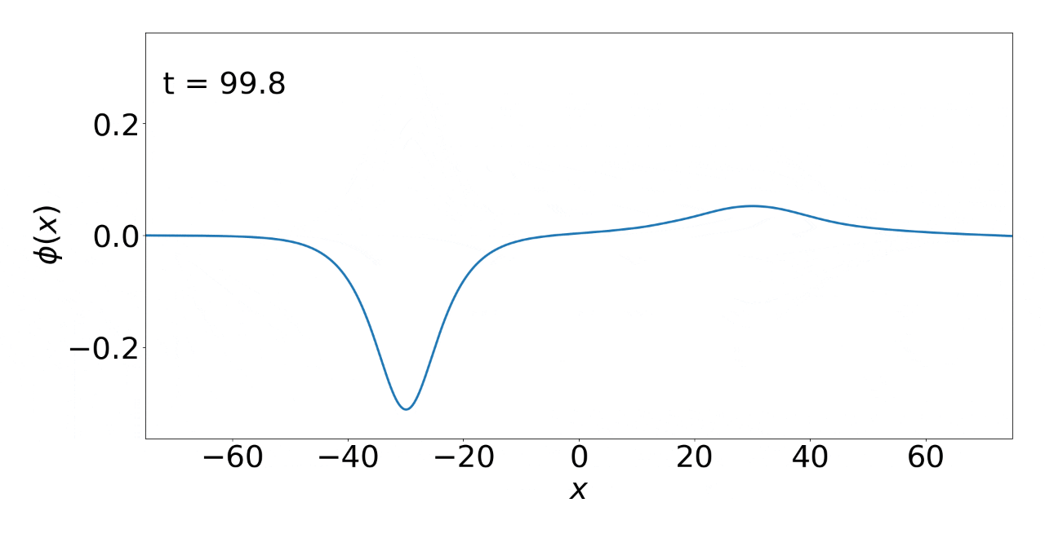
Unequal Amplitude Oscillons

Slide 11

Numerical Simulations
Leapfrog finite difference scheme
Absorbing boundary conditions
Tracked the center of the left oscillon
Computed acceleration from “fitted” trajectories
Tracked oscillon with amplitude $ε_{1}$

Slide 12
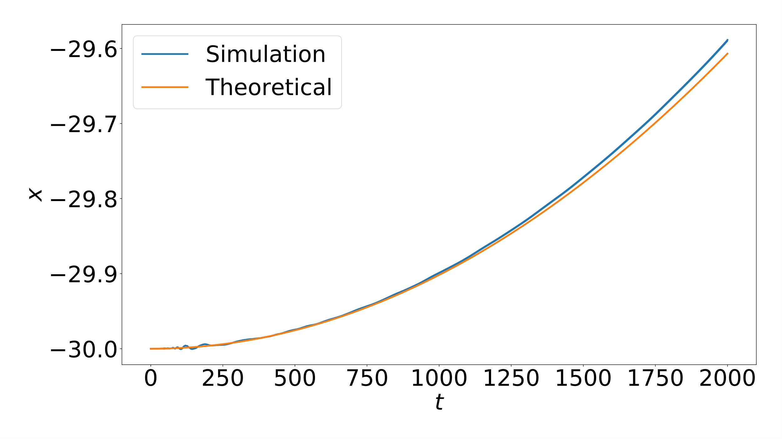
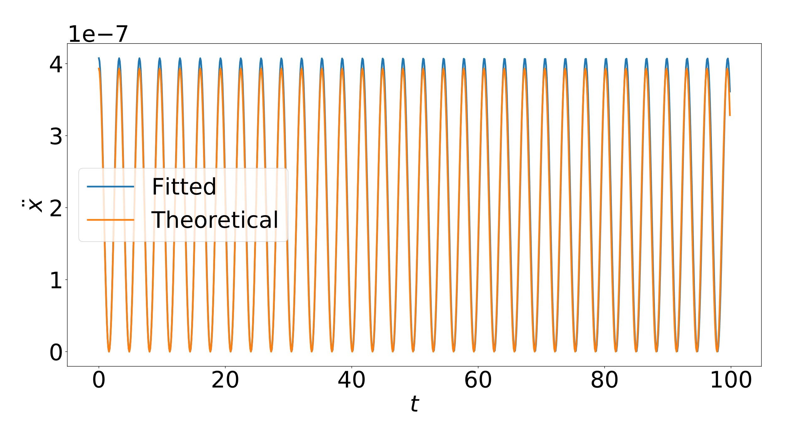
$$ε=0.2, θ=0$$
Oscillon Center Trajectory
Oscillon Acceleration

Slide 13
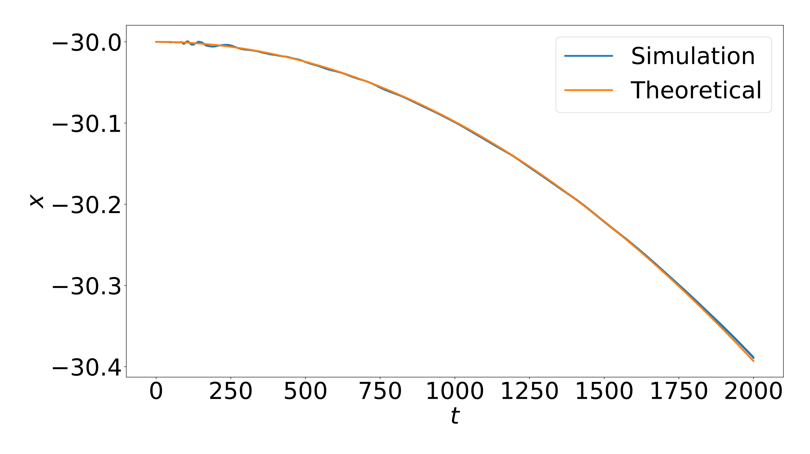
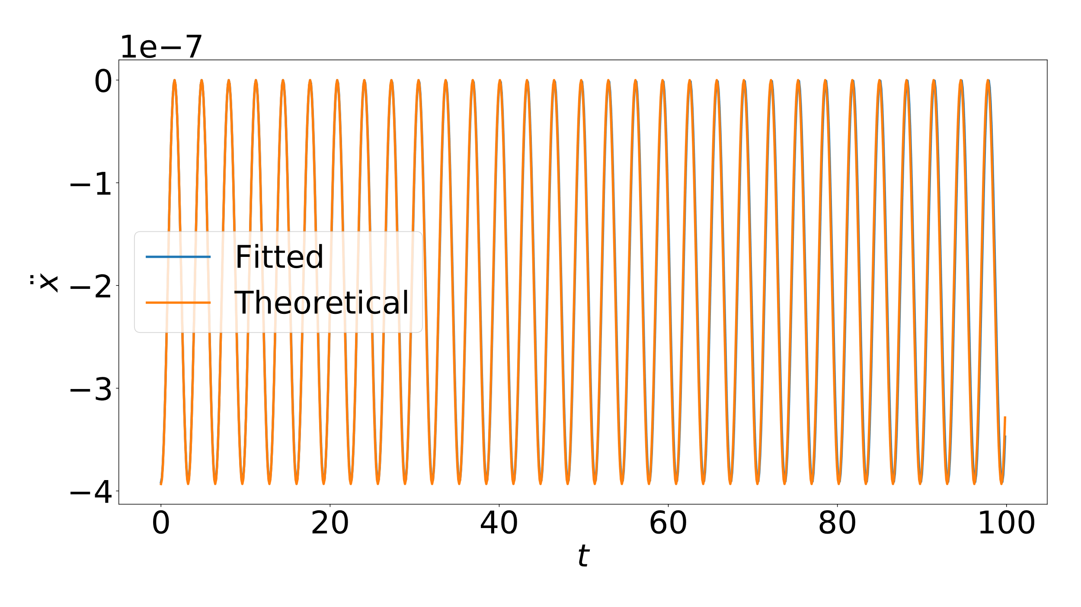
$$ε=0.2, θ=π$$
Oscillon Center Trajectory
Oscillon Acceleration

Slide 14
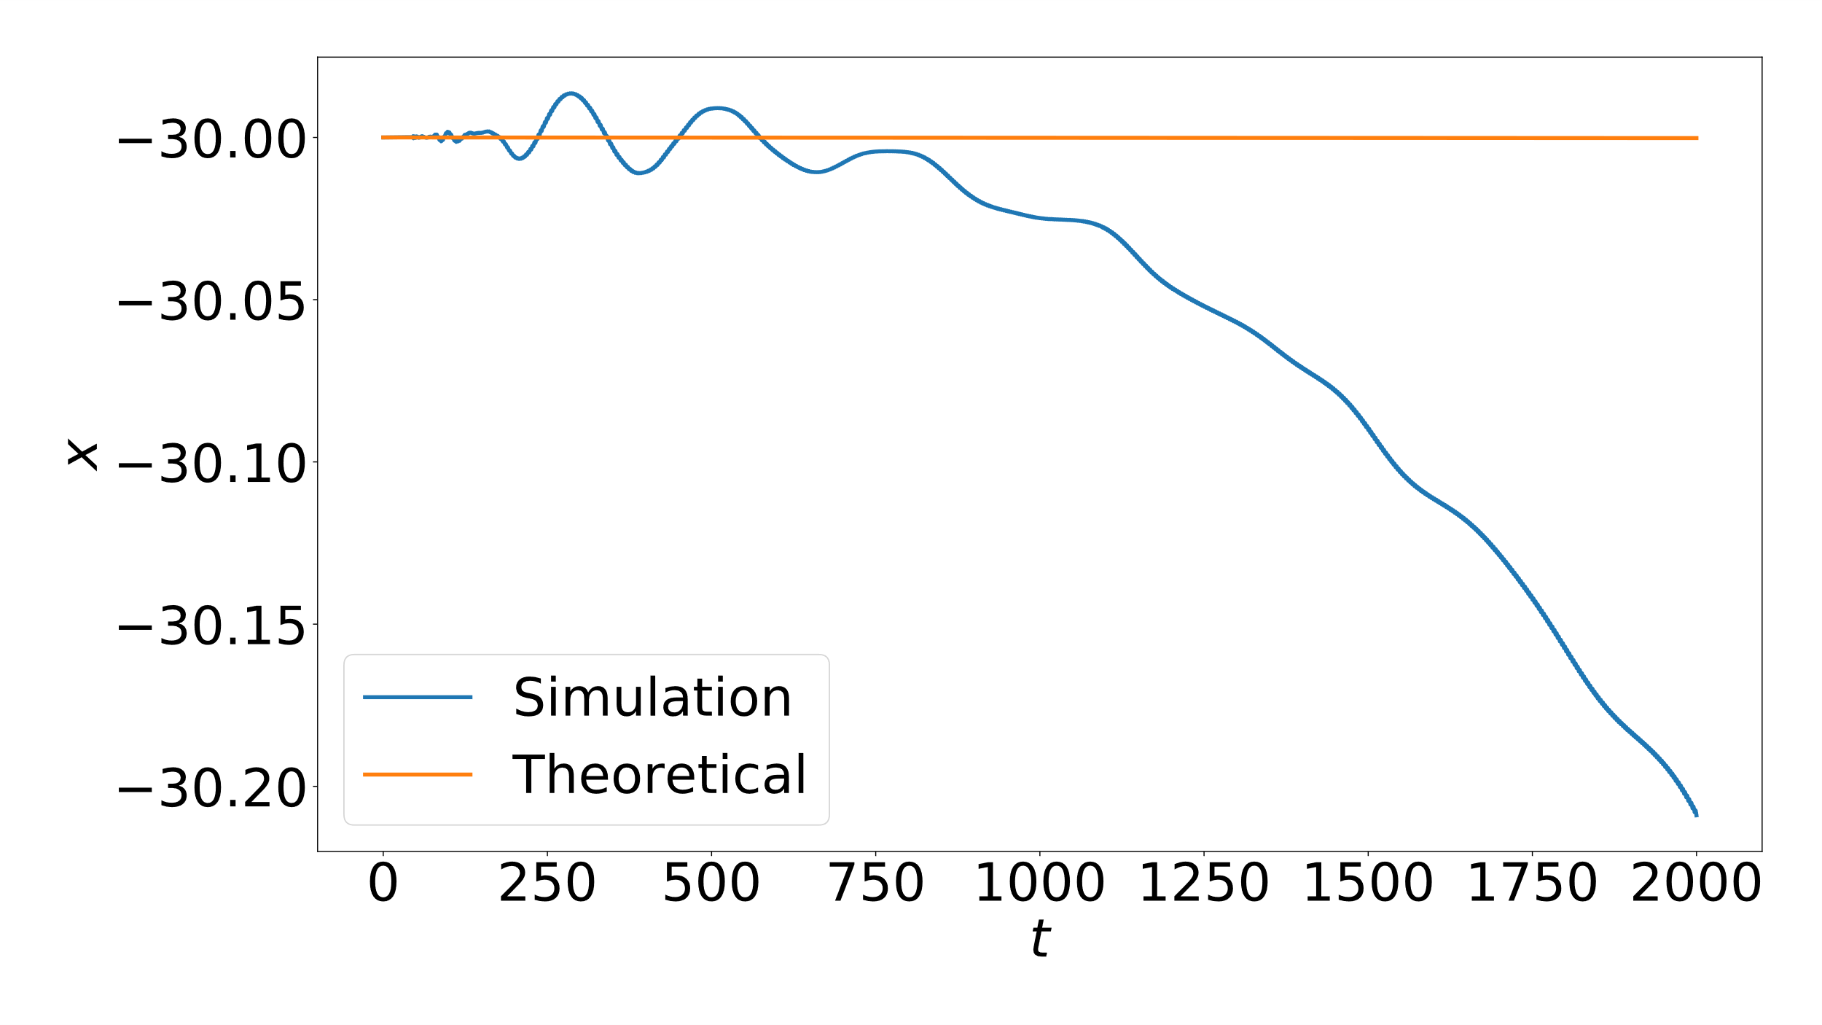
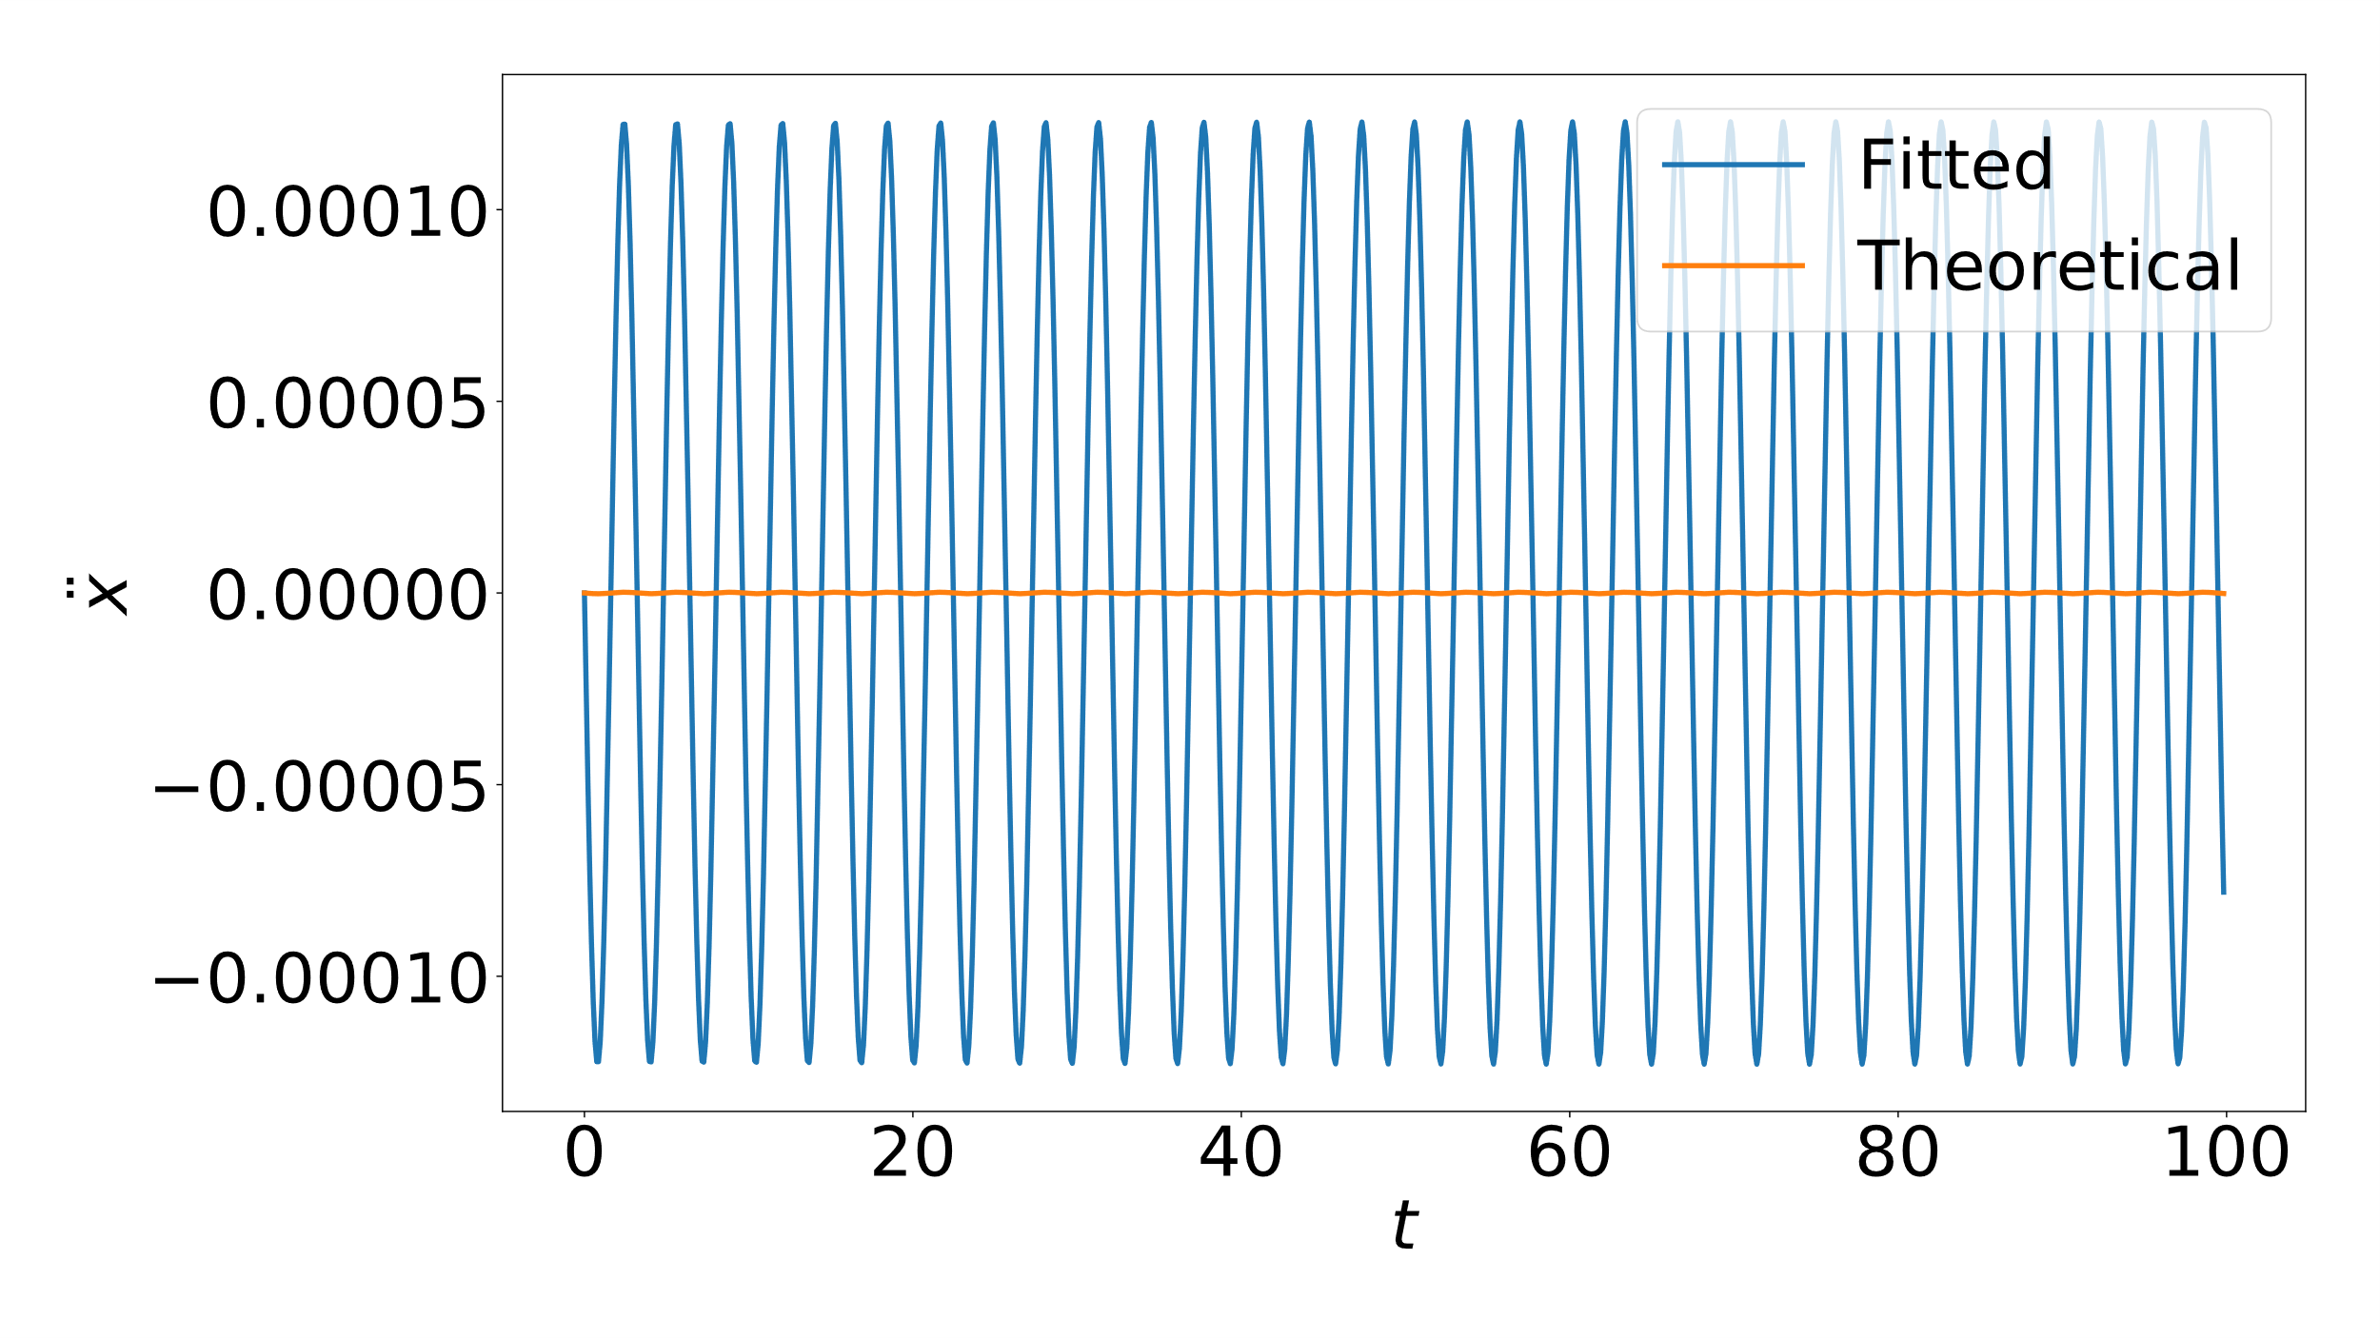
$$ε=0.2, θ=\frac{π}{2}$$
Oscillon Center Trajectory
Oscillon Acceleration

Slide 15
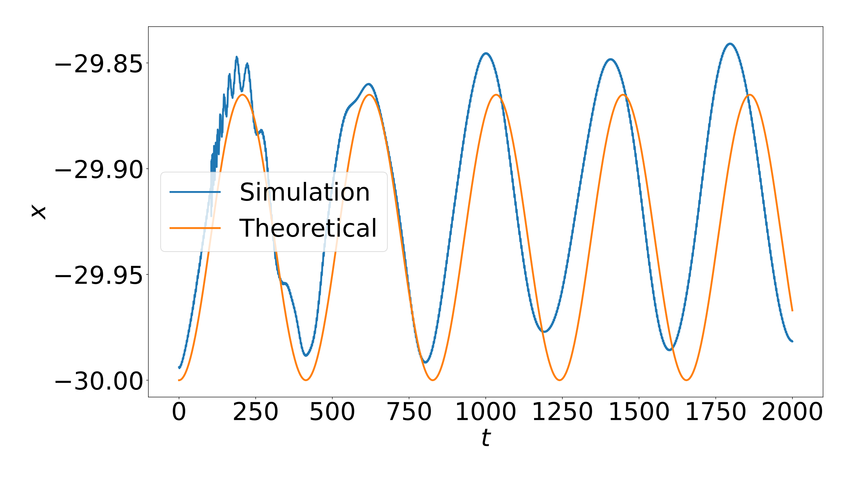
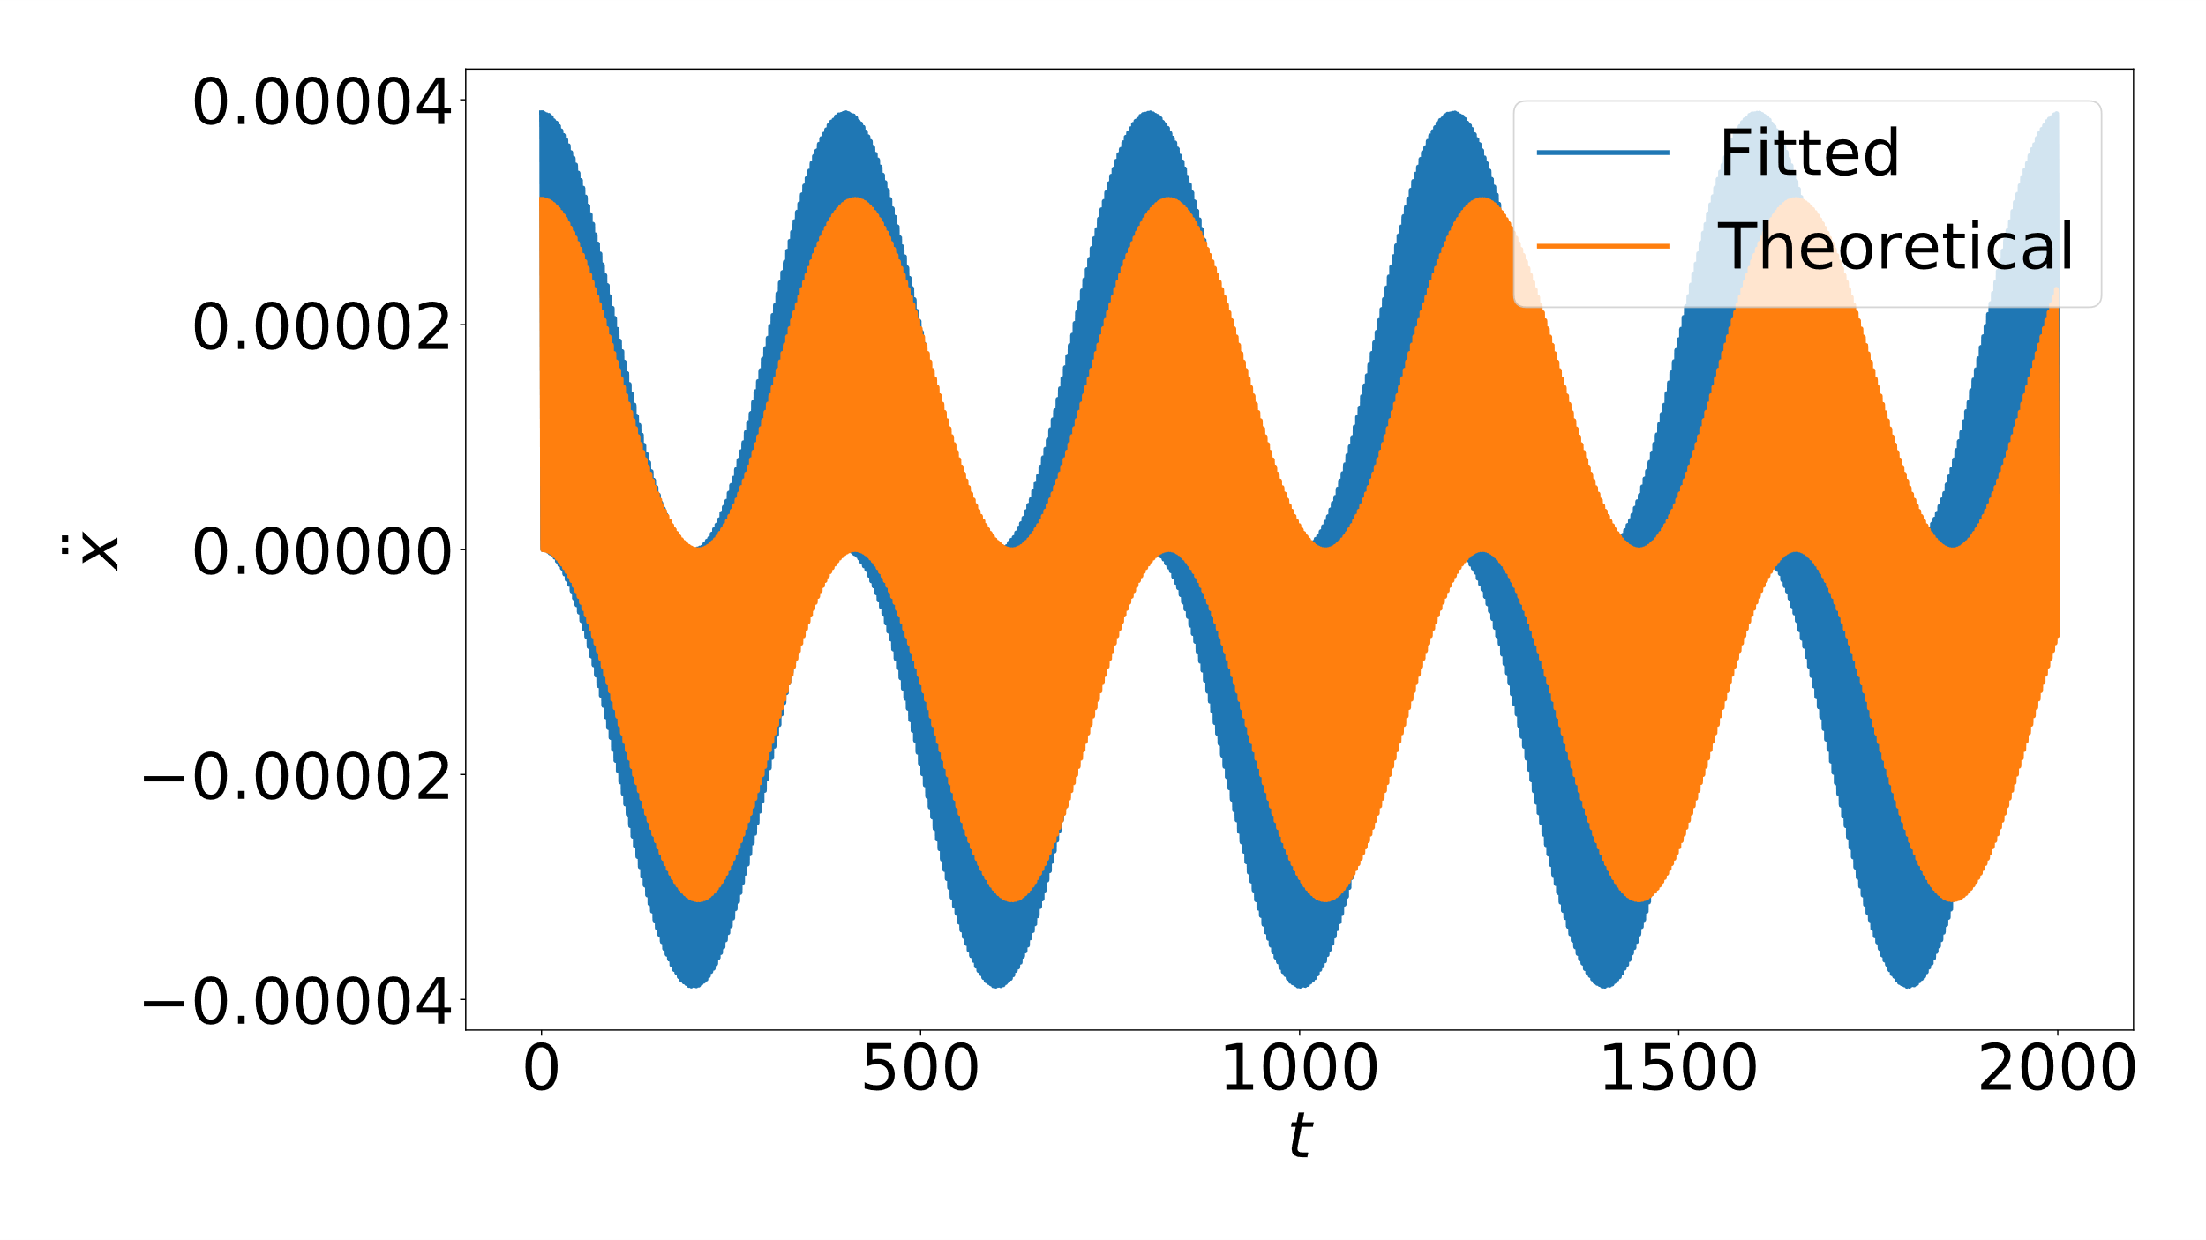
$$ε_{1}=0.2, ε_{2}=0.1, θ=0$$
Oscillon Center Trajectory
Oscillon Acceleration

Slide 16
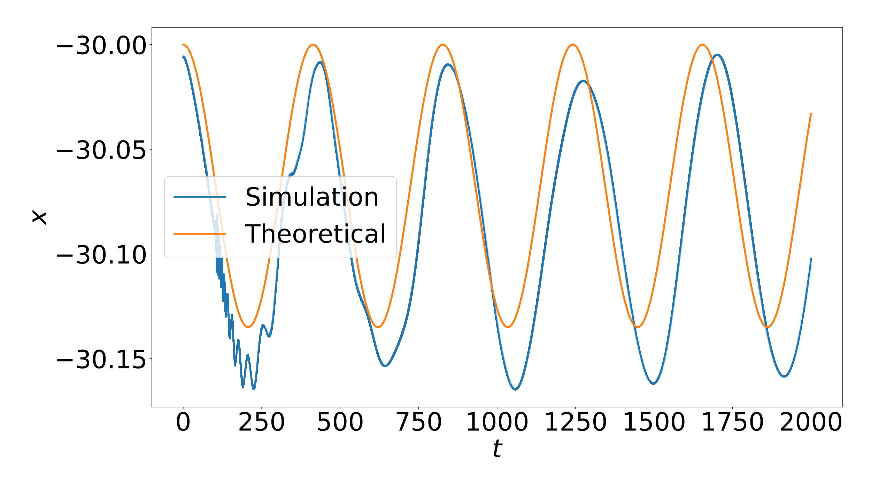
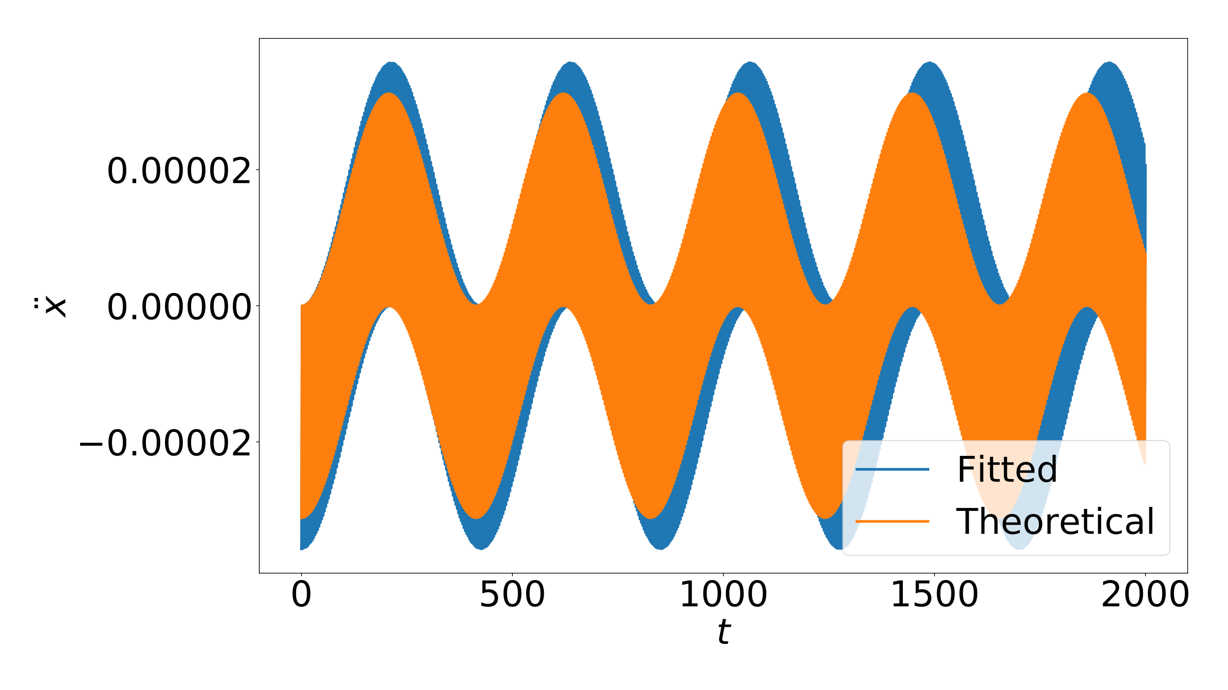
$$ε_{1}=0.2, ε_{2}=0.1, θ=π$$
Oscillon Center Trajectory
Oscillon Acceleration

Slide 17
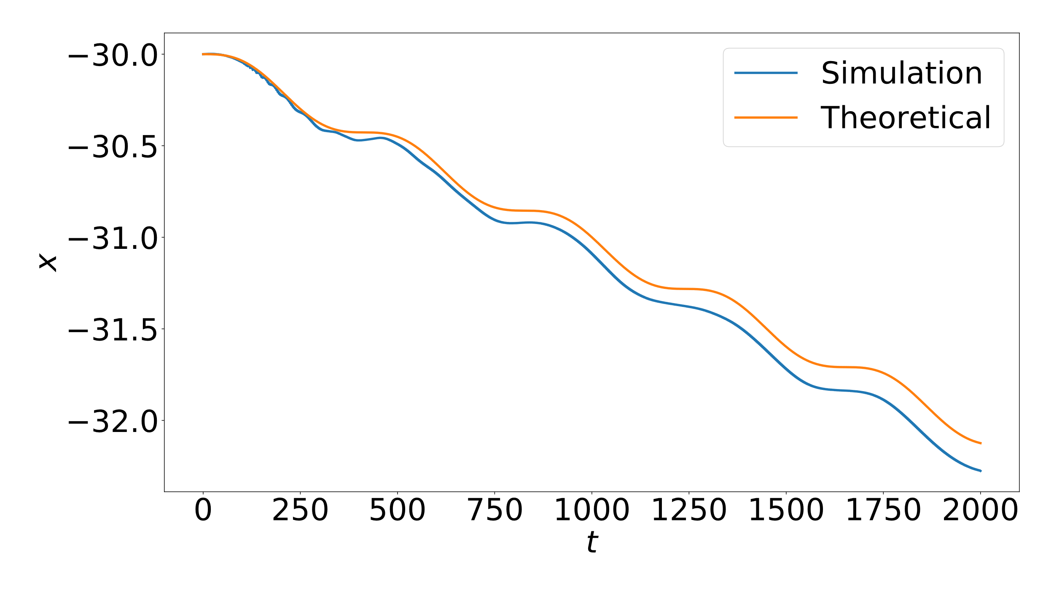
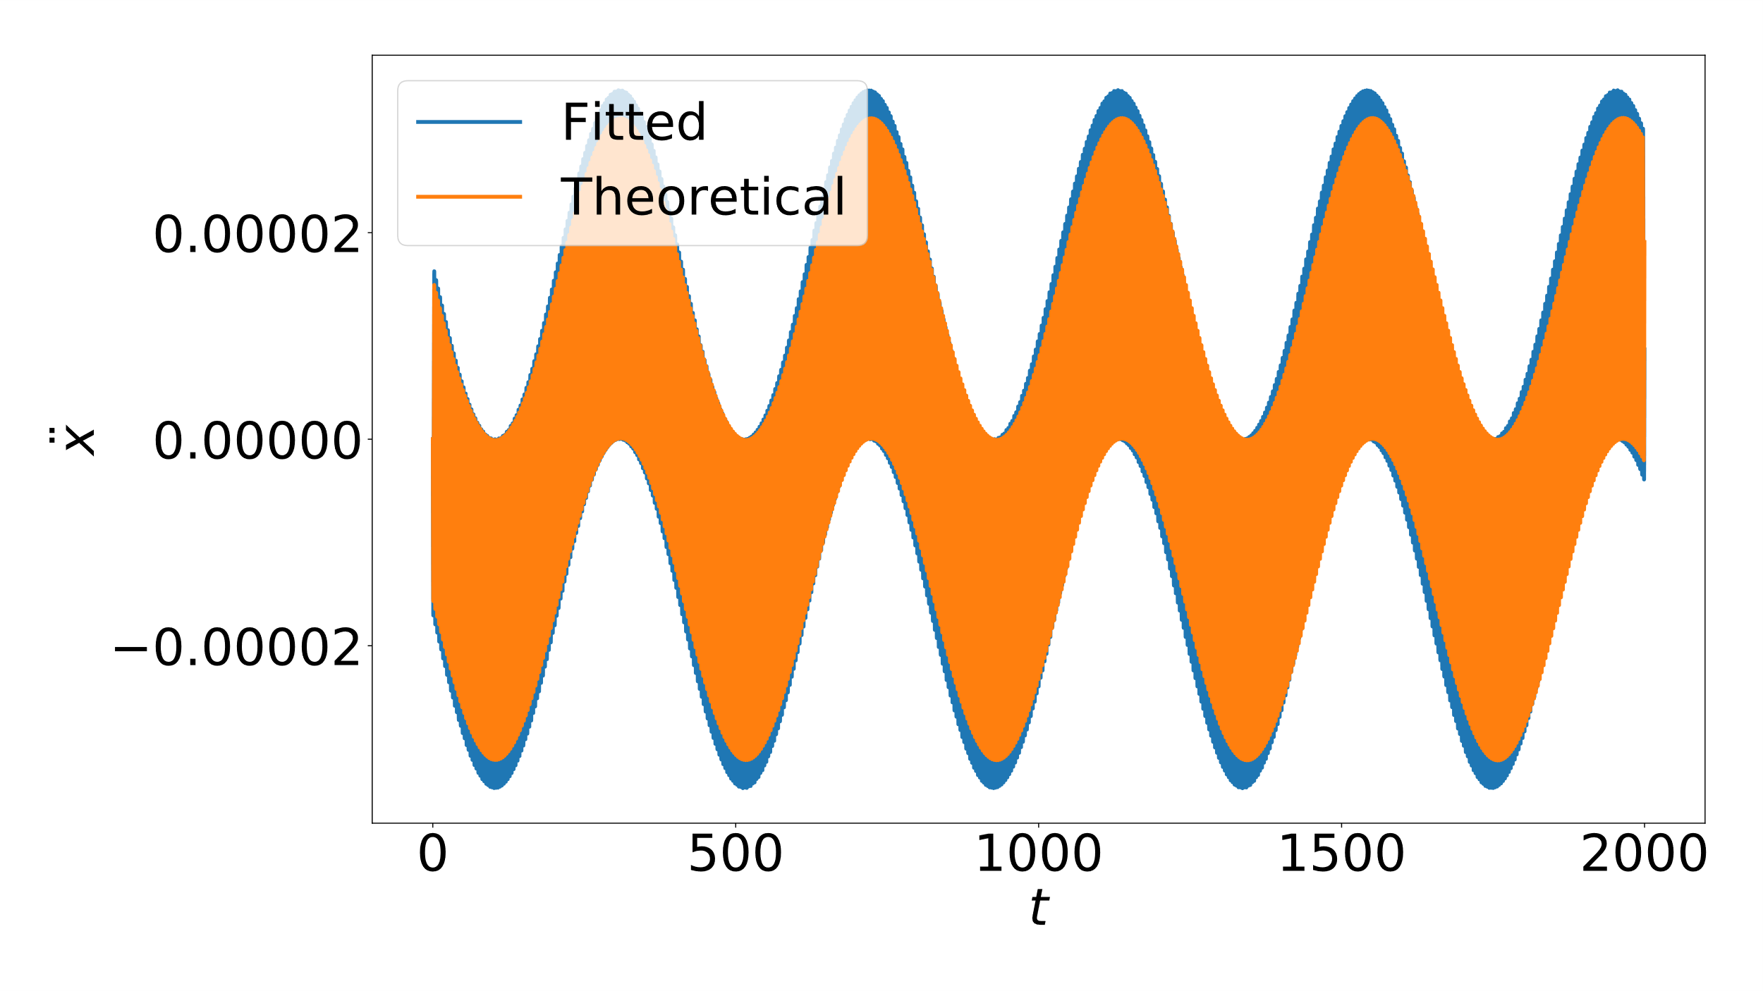
$$ε_{1}=0.2, ε_{2}=0.1, θ=\frac{π}{2}$$
Oscillon Center Trajectory
Oscillon Acceleration

Slide 18
Conclusions and Future Steps
In and out of phase calculations agree well in the equal amplitude case
Qualitative agreement in the unequal amplitude case
Discrepancies may be explained by energy transfer between the oscillons
Extend theory 1+1 D to oscillons with relative velocities
Simulate in 3+1 D spacetime

Slide 19
Acknowledgements
Work supported by the Rorschach scholarship from the Rice P&A department
Dr. Mustafa Amin (Advisor)
Hongyi Zhang (Graduate Student, Rice)
Rohith Karur (Undergraduate Student, UC Berkeley)

Slide 20
Questions?

